Slide 1
Supplementary Explanations
to the
F
Notes:
For any performing sport, we need principles to make qualitative assessment. Use tools:
A judge’s tools are:
Knowledge
Experience
Sporting Code
A competitor’s tools are:
Knowledge
Experience/exposure
Sporting Code
Talent
Skill
Tenacity
Desire
Dedication
Money
For radio control aerobatics, we have four principles, and in order of importance…

Slide 2
The purpose
of the
Manoeuvre Execution Guide
is to give
accurate guidelines
for the proper execution of aerobatic manoeuvres
to both, judges and competitors
Notes:
To assess quality of manoeuvres
Only guide to competitors of how good they are, is performance of judging
Qualities of a good judge…

Slide 3
The flight path of a model aircraft
is used to judge the
shape of all manoeuvres
Every manoeuvre must be
entered and exited with a
straight level upright or inverted flight
of recognisable length
Notes:
To assess quality of manoeuvres
Only guide to competitors of how good they are, is performance of judging
Qualities of a good judge…

Slide 4
JUDGING
STANDARDS. . .
Notes:
To assess quality of manoeuvres
Only guide to competitors of how good they are, is performance of judging
Qualities of a good judge…

Slide 5
QUALITIES OF A GOOD JUDGE…
CONSISTENCY
JUDGING ACCURACY
IMPARTIALITY

Slide 6
CONSISTENCY
Minor defect on manoeuvre 3 = score 9
Minor defect on manoeuvre 7 = score 9
Major defect on manoeuvre 9 = score 4
Major defect on manoeuvre 11 = score 4
Minor defect on manoeuvre 12 = score 6
Major defect on manoeuvre 15 = score 9
(Scores must be in the same range,
for similar defects)
Notes:
MOST IMPORTANT QUALITY = CONSISTENCY!
Establish standard, and maintain, no matter what
Scrooge or Santa Claus, wont affect outcome
Best will win, and ranking will be correct
Judges on panel may be consistent, and in close agreement, BUT NOT ACCURATE
Don’t be 5-6-7 judge. Use full spread of scores. Use 10’s, and zero’s!
Difficult to measure accuracy. Nobody can dictate what score you must give. Work independently.
Don’t be influenced by other scores

Slide 7
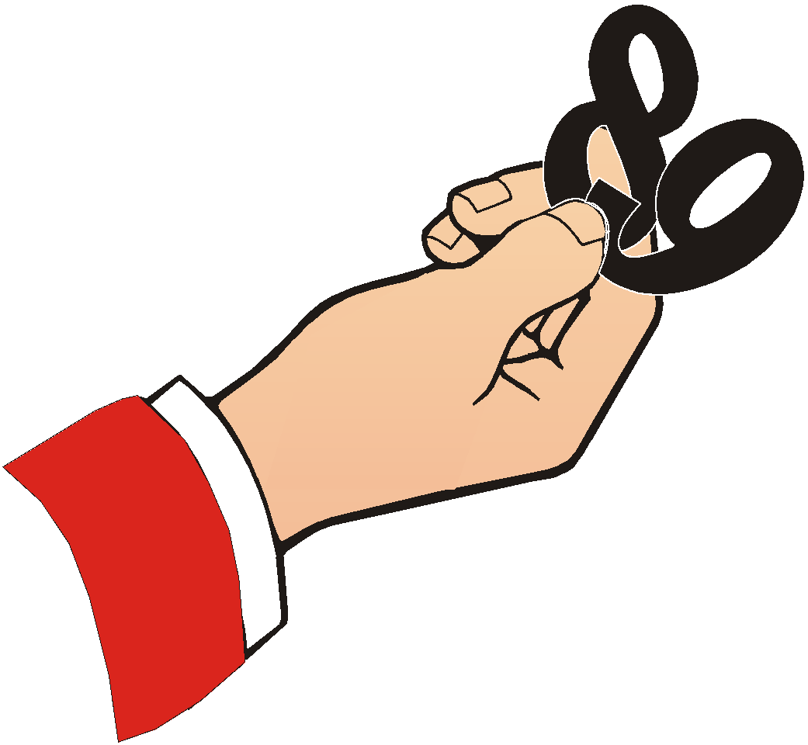
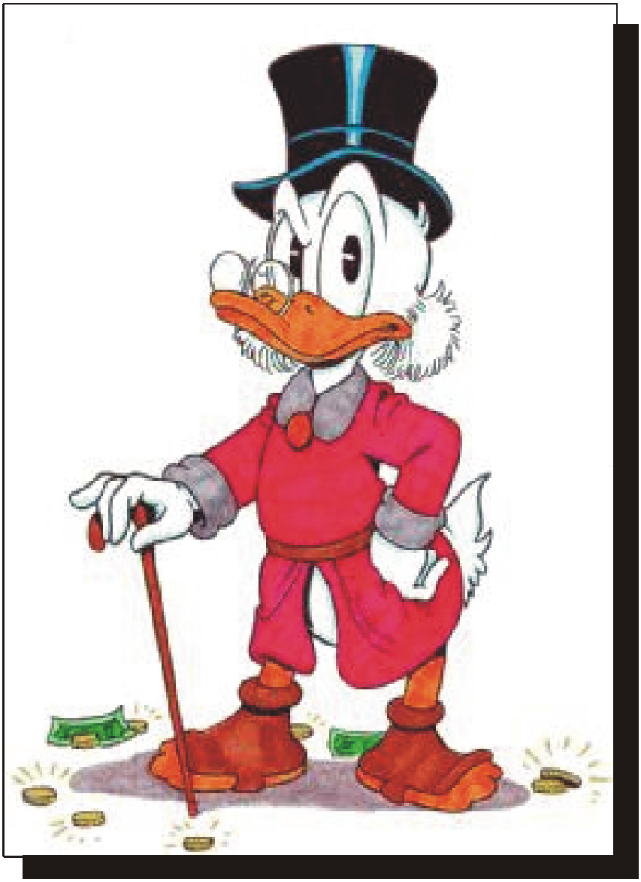
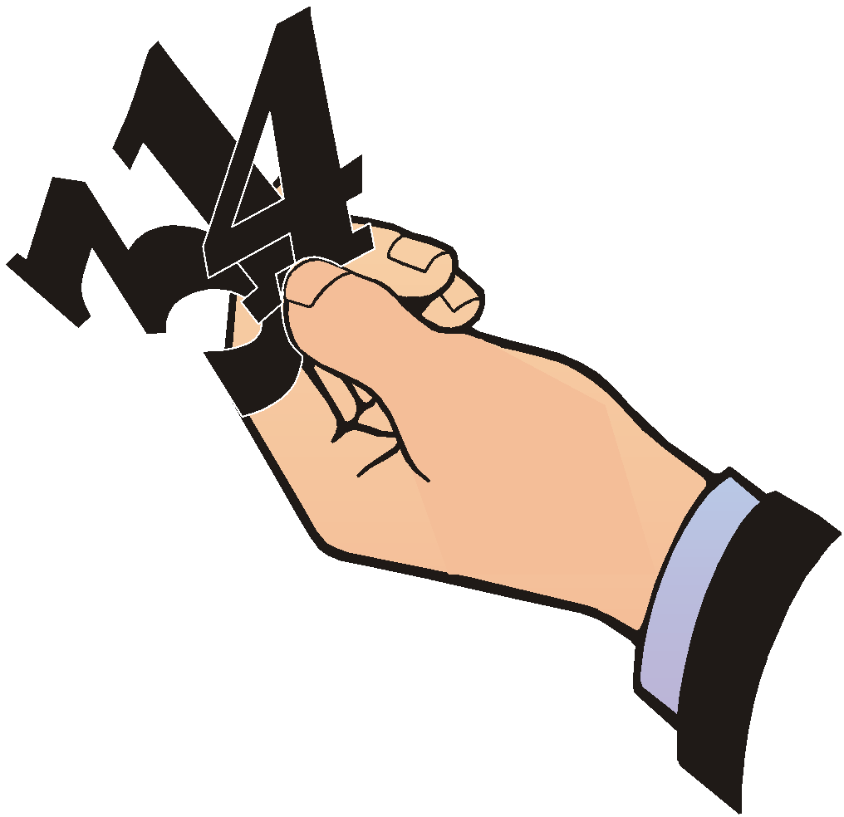
Santa
Claus...
Or Scrooge!

Slide 8
Judging ACCURACY
Downgrade by 1 point for a minor defect
Downgrade by 2 points for a larger defect
Downgrade by 3, 4, 5, more points for major defect
Do NOT downgrade 4 points for a minor defect
Do NOT downgrade 1 point for a major defect

Slide 9
IMPARTIALITY
A judge must not, under any circumstances, favour a competitor, or a national team, or a particular flying style, or brand of equipment, or propulsion method.
Judges must only look at the lines of manoeuvres described in the sky.

Slide 10
IMPARTIALITY
Conversely, acts of negative bias towards a competitor, or a national team, or a flying style, or brand of equipment, or a propulsion method, must be viewed in a serious light, and corrective action may be necessary.

Slide 11
IMPARTIALITY
Forget WHO is flying
(friend, rival, countryman, flier from other nation)
Forget WHAT is flying
(2-stroke, 4-stroke, electric, turbine, rubber-power)
LOOK ONLY AT LINES DESCRIBED IN THE SKY!
(and the precision, smoothness, positioning, and size)

Slide 12
MAINTAIN YOUR
STANDARD!
PILOT 1 480 - 1,2 495 +8,8 477 -4,2 484 +2,8 470 - 11,2
PILOT 2 364 - 14,8 385 +6,2 416 +37,2 374 - 4,8 355 - 23,8
PILOT 3 491 - 2,6 513 +19,4 486 - 7,6 496 +2,4 482 - 11,6
PILOT 4 505 +9,4 502 +6,4 461 -34,6 511 +15,4 491 - 4,6
PILOT 5 460 - 3,0 477 +14,0 432 -31,0 464 +1,0 482 +19

Slide 13
PRINCIPLES
THE PRINCIPLES of flying and judging
the performance of a competitor
in an R/C Aerobatic competition,
is based on the PERFECTION with which
the competitor’s model aircraft
executes the aerobatic manoeuvres
as described in Annex 5A.

Slide 14
Geometrical
accuracy
of the manoeuvre
Notes:
Or ACCURACY
Most important principle. No good to have nice style, smoothness and gracefulness, if precision is lacking
ENTRY and EXIT very important
Perfectly horizontal, vertical, and angled lines
Same sized part-loops
Rolls in middle of lines
All about balance, symmetry.

Slide 15
Smoothness
and gracefulness
of the manoeuvre
Notes:
Self-explanatory
Inter-related with size and flying speed
No sudden angular jerks, or high-G loops
Constant roll rate and rotation
Presence = Satisfying feeling that causes judge to give 9 instead of 8, despite few small mistakes
Absence = Uncomfortable feeling of judge, who gives 8 instead of 9 for otherwise good manoeuvre
All about poetry in the sky!

Slide 16
Positioning of the manoeuvre
within the manoeuvring zone
Notes:
Or DISPLAY
Must be easy to view, easy to judge
Longitudinal distance. Too far makes for difficult judging
Within manoeuvring zone, or “box”
Centre manoeuvres directly opposite judges
Turnaround manoeuvres at ends
High flying, over 60 degrees will be penalised

Slide 17
Size
of the manoeuvre
Notes:
Lot to do with size of model aircraft, and flying speed.
Small tight manoeuvres (even if in box) not appealing
High rates of roll, pitch, and yaw not appealing
Manoeuvres should not vary in size

Slide 18
WEIGHTING
Size
Positioning
Geometrical
accuracy
Smoothness
and gracefulness
Notes:
CAUTION: GENERAL GUIDE ONLY!
50% = Precision
25% = Smoothness & Gracefulness
±17% = Positioning
8% = Size

Slide 19
Proportion of the manoeuvres outside of the manoeuvring zone

Slide 20
100% PRECISION
+
SMOOTHNESS & GRACEFULNESS
+
CORRECT POSITIONING
+
CORRECT SIZE
=
NO DOWNGRADE
=
10 POINTS!
Notes:
Pilot who combines all four, has COMPETITIVE ADVANTAGE!

Slide 21
ALWAYS
START WITH PERFECT 10 ...
Then 9…8…7…6…5…4…etc.
Or 10…7…6…2…etc.
As the pilot starts!

Slide 22

IMPRESSION
ONLY
DEDUCT/
DOWNGRADE
SYSTEM
Notes:
May want to temper score, with impression - because smoothness and gracefulness are matters of impression, rather than specifics.
IMPRESSION METHOD ONLY SHOULD NEVER BE USED!

Slide 23
GENERAL CRITERIA FOR
DOWNGRADING MANOEUVRES
“Criteria…are standards by
which something can be judged”
Notes:
Definition of criteria...

Slide 24
WHAT WAS THE DEFECT, or mistake?
Over, or under-rolling (or spin, or snap)
Poor shape or geometry
Rolls not on middle of lines
Absence of lines
Entry, exit poor
Wrong angles
Misrelation between line lengths
Different roll rates
Etc.
Notes:
WHAT TYPE OF DEFECT?
Angle wrong?
Part-loops different?
Differing line lengths?
Positioning defect?
Other?

Slide 25
2. HOW SERIOUS was the defect, or mistake?
Was it big (major)?
Or was it small (minor)?
Notes:
Is it a small heading change, or almost unnoticeable? Low wing not picked up? Slight angular change?
DEDUCTS PROBABLY ONE, OR TWO POINTS.
Or is it a large defect? Easily spotted? Severe over-roll? Wing over in stall?
Snap entry to spin?
Barrel roll
Very noticeable heading/track change?
DEDUCTS LIKELY TO BE THREE, FOUR, FIVE, AND MORE, PERHAPS EVEN 10 POINTS!

Slide 26
3. HOW OFTEN did you see the same defect,
or mistake in a particular manoeuvre?
How many defects were there in TOTAL?
Notes:
If it were repetitive?
And how many defects in total?

Slide 27
4. WHAT WAS THE POSITIONING of the manoeuvre?
Notes:
Right on 150m-mark?
Too far, or too close?
Off-centre, or out of box?
Too high, or too close?
Off-heading/track?

Slide 28
5. WHAT WAS THE SIZE of the manoeuvre?
Notes:
Relative to manoeuvring area, and to other manoeuvres?

Slide 29
5. Was the manoeuvre partially or completely
outside of the manoeuvring zone?

Slide 30
Now translate these
DEFECTS… or MISTAKES
into
DEDUCTS… or DOWNGRADES
Notes:
ALWAYS START WITH PERFECT 10!
Deduct and arrive at score, using previous criteria

Slide 31
IMPARTIALITY 2
Forget WHO is flying
(friend, rival, countryman, flier from other nation)
Forget WHAT is flying
(2-stroke, 4-stroke, electric, turbine, rubber-power)
LOOK ONLY AT LINES DESCRIBED IN THE SKY!
(and the precision, smoothness, positioning, and size)

Slide 32
CRITERIA FOR JUDGING
INDIVIDUAL MANOEUVRES
(Method)
Notes:
How do we approach individual manoeuvres?
What method exists for arriving at a score for each manoeuvre?
How does one determine deducts?
FIRST CRITERIUM...

Slide 33
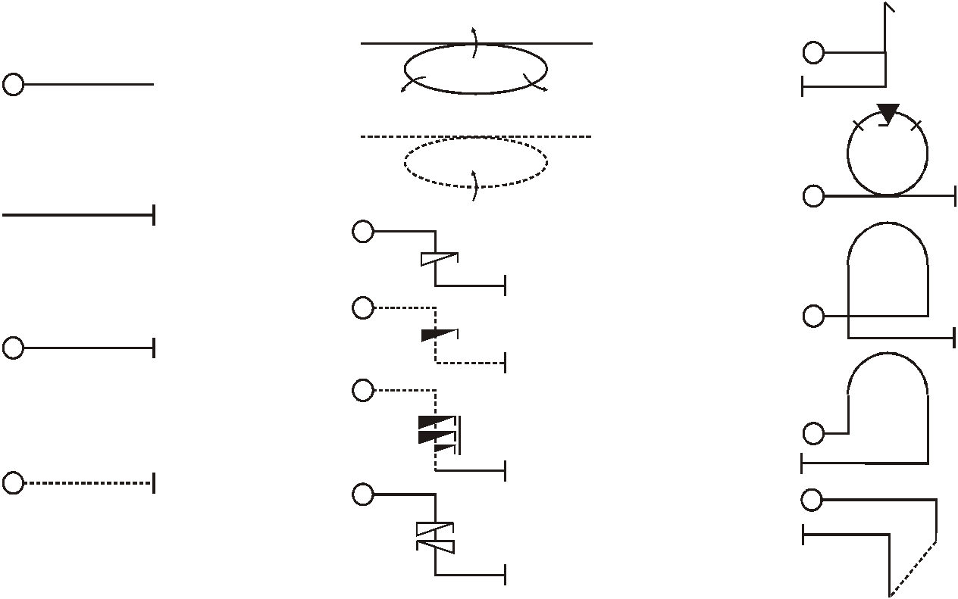
ARESTI SYSTEM
Rolling circle
(3 outside)
Stall turn
Start of
manoeuvre
Inverted rolling
circle (1 inside)
Avalanche
(negative snap)
End of
manoeuvre
Positive G spin (upright)
Humpty bump
(centre)
Negative G spin (inverted)
Upright,
positive G
2 1/2 Negative spin (inverted)
Humpty bump
(turnaround)
Inverted,
negative G
2 Positive G spins (reverse direction)
Cross-box manoeuvre (horizontal flight always inverted)
Notes:
Aresti families. Manoeuvres catalogues into groups:
Lines
Loops
Rolls
Stall turns
Snap rolls
Spins
Combinations
(Tail slides)

Slide 34
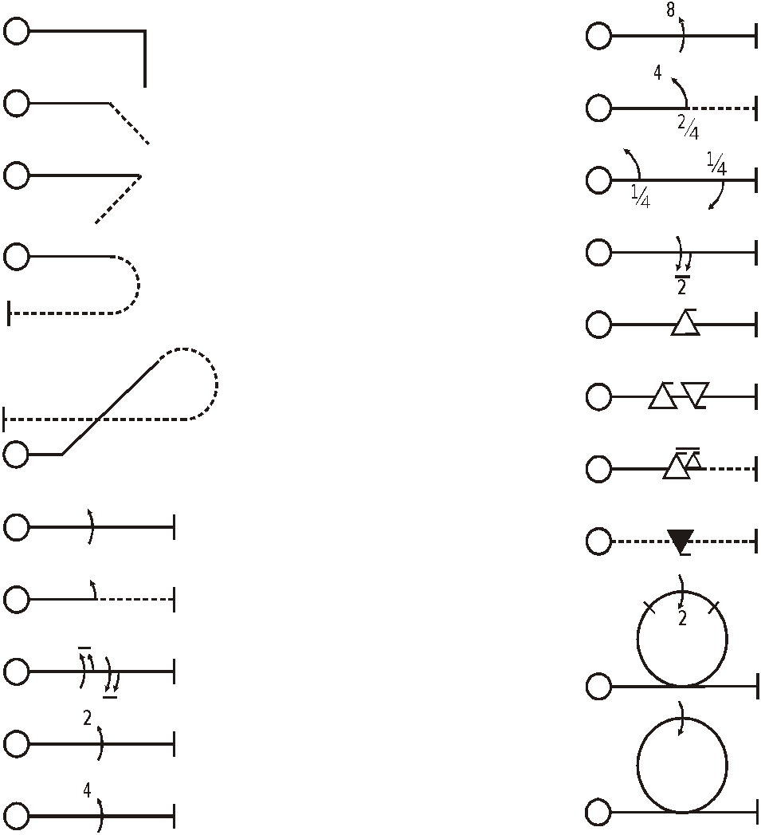
90⁰ angle/corner
(1/4 loop)
8-point roll
450 (1/8 loop)
2 of 4-point roll
ARESTI
SYSTEM
1350 (3/8 loop)
Knife-edge flight
1800 (1/2 loop)
3 of 2-point roll
Positive G snap roll
1/8 loop and
5/8 loop
2 snaps opposite
1 1/2 positive G snaps
Slow roll (aileron)
Negative G snap roll
Half roll
Loop with 2-point roll (contained to top of loop)
1 1/2 rolls, reversed
2-point roll
Rolling loop (roll is integrated with loop)
4-point roll

Slide 35
ATTITUDE vs. FLIGHT PATH

Slide 36
Windcorrection
Alle manoeuvres are required to be windcorrected,
except SNAPROLLS, SPINS, and STALL TURNS
(the model aircraft is in stalled condition)

Slide 37
Wind Correction
Flight path of model aircraft
must describe correct geometric shape
Flight
path
Fuselage
attitude
Notes:
ALL MANOEUVRES WIND CORRECTED, so that geometric shape is preserved in model aircraft’s flight path.
Back to accuracy, precision, symmetry, and geometric shapes.

Slide 38




1 POINT PER 15⁰ DEVIATION
Perfect geometry =
No downgrade
Up to 15⁰ error =
1 point downgrade
Up to 30⁰ error =
2 point downgrade
Up to 45⁰ error =
3 point downgrade
Wings level -
roll axis
Horizontal lines -
pitch axis
Notes:
Use general downgrading guide

Slide 39
1 POINT PER 15⁰ DEVIATION
Perfect geometry =
No downgrade
Up to 15⁰ error =
1 point downgrade
Up to 30⁰ error =
2 point downgrade
Vertical lines -
pitch axis
Vertical lines -
yaw
axis
Notes:
Downgrade deviations from defined manoeuvre geometry

Slide 40
1 POINT PER 15⁰ DEVIATION
In general, lines must be judged more critically than deviations in yaw and roll.

Slide 41
LINES
Horizontal
90⁰
60⁰
45⁰

Slide 42
LINES
Minor mis-relation between line lengths = minus 1 point!
No line
after roll… = minus
3 points!
No line
between
manoeuvres…
= minus
1 point here…
and minus 1 point here!
Line after and
Before roll =
not equal…
minus
2 points!
(This example maybe
minus 2 or 3!)
Notes:
ALL manoeuvres start and finish by horizontal line
All have beginning and end, preceded and followed by part-loops (mostly)
Total length of line, if vertical, not criterion. Length only graded when several lines within manoeuvre have given relationship, like 6-sided loop, or square loop.

Slide 43
LOOPS

Slide 44
LOOPS
Radii too tight...
…too open/loose...
Good compromise!
Each
segmentation...
minus
1 point!
Radius too
tight
All part-loop
radii equal.
Minor mis-relation…
minus 1 point!
This = minus 2 points!
Radius of first loop
determines rest
Notes:
For round loop, by definition must have constant radius, and in vertical plane
Starts and finishes by well-defined line, either horizontal, vertical, or angled.
No drift (downgrade by 1 to 3 points, or more)

Slide 45
Rolls
(Continous Rolls and Part-Rolls)

Slide 46
ROLLS
Roll not on
middle of line... This example,
minus 3 points!
Roll rate not constant (increasing here)… this example minus
3 or 4 points!
Difference in roll rate…
minus 1 point!

Slide 47
ROLLS
Roll rate of
Part-rolls
may be
different to roll rate of
continuous
rolls
Not equal length of lines between part- rolls
minus 1 point for each!
Different roll rate… minus 1 point!
Between consecutive continous rolls and part-rolls in opposite direction there must be no line!

Slide 48
Missing or additional Part-Rolls:
Use the 1 point for 15° rule
1 missing ½ roll: (180 degrees) = Zero points
1 missing ¼ roll : (90 degress) = - 6 points
1 missing 1/8 roll : (45 degrees) = - 3 points
analogue with additional part-rolls

Slide 49
SNAP ROLLS
A SNAP ROLL is basically a spin in the horizontal axis.
The model aircraft rolls rapidly, with a
continuous high angle of attack
(positive or negative).
The tail should describe a corkscrew path.

Slide 50
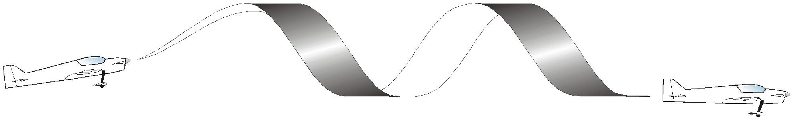
SNAP ROLLS
“BREAK”
here
FLIGHT PATH (centre of gravity) must be level
Barrel roll(s) and axial rolls are severely
downgraded…more than 5 points!
Separation of fuselage attitude
from flight path

Slide 51
SNAP ROLLS
NEGATIVE SNAP ROLL _
DOWN elevator
POSITIVE SNAP ROLL +
UP elevator

Slide 52
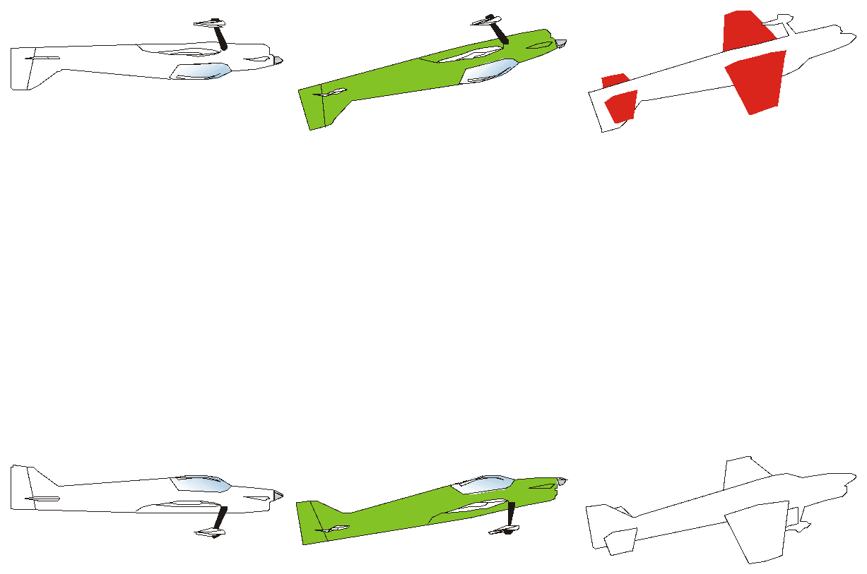
SNAP ROLLS, DOWN (and UP)
NEGATIVE SNAP
= DOWN elevator
NEGATIVE SNAP
= DOWN elevator
POSITIVE SNAP
= UP elevator

Slide 53
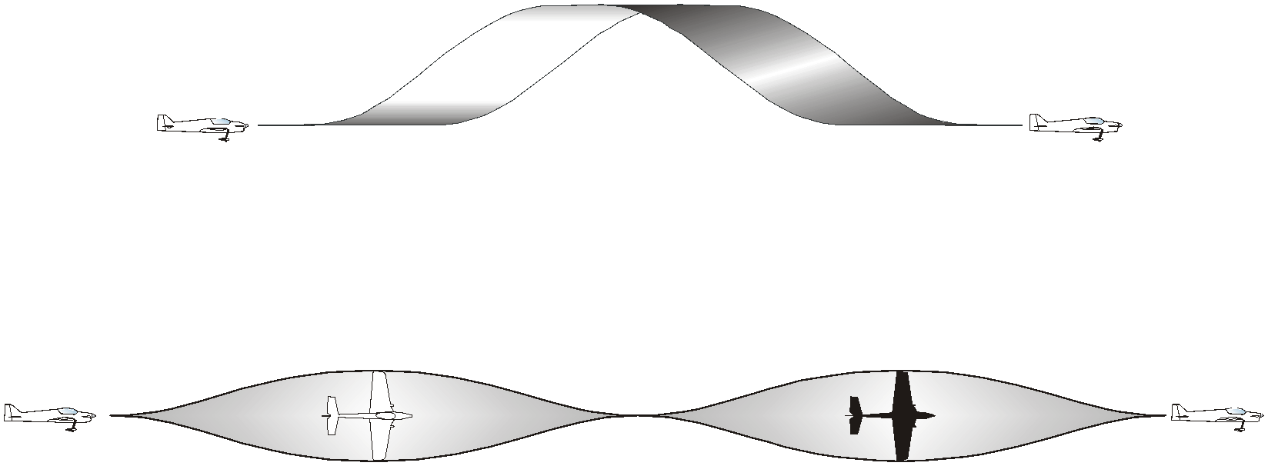
Barrel roll or axial roll instead of snap roll:downgrade more than - 5 points

Slide 54
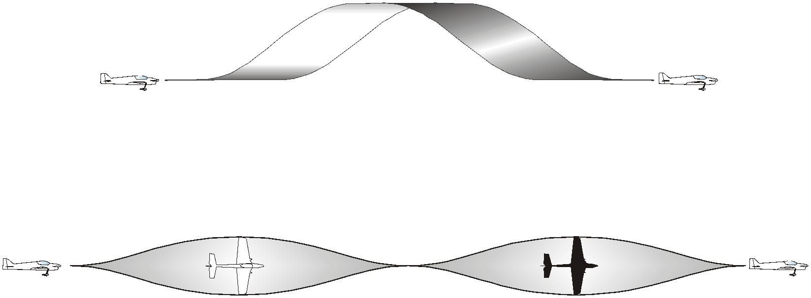
“SPOTTER’S GUIDE TO SNAP ROLLS”
If it is not a BARREL ROLL...
…and it’s not an an AXIAL ROLL...
…then it’s probably...
A SNAP ROLL!

Slide 55
Horizontal Circles
(Rolling Circles)
• Constant high or low altitude
• Circular flight path maintained
• Continuous rolling, at constant rate
• Rolls positioned correctly
• Any reversals to be immediate

Slide 56
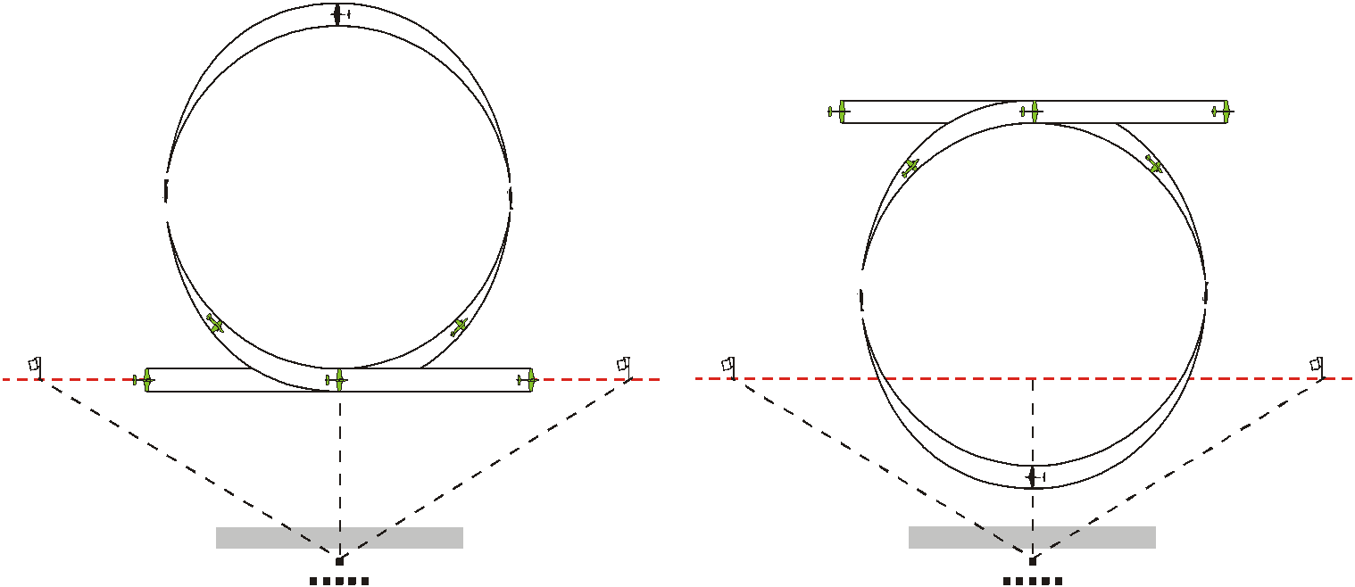
Horizontal Circles
(Rolling Circles)
May be AWAY from competitor…
…towards competitor.
OR…

Slide 57
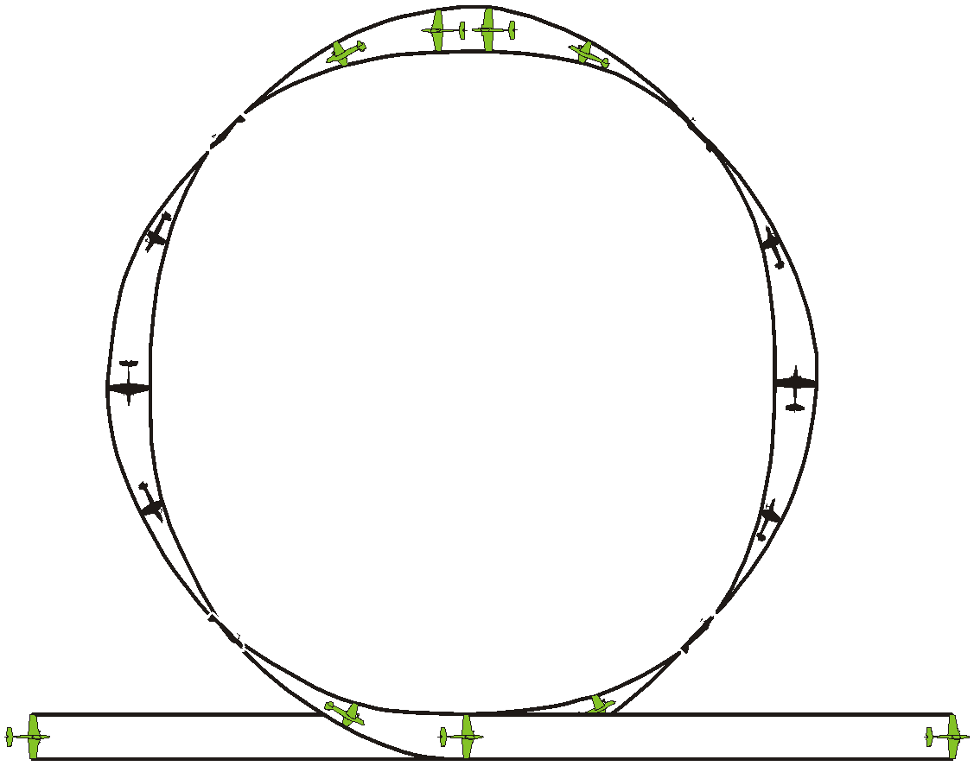
Horizontal Circles
(Rolling Circles)
Reversal is immediate
Second roll to inside
Constant
Roll rate
At 270º position of circle
With one roll to outside,
and one roll to inside
At 90º position of circle
First roll to outside

Slide 58
Line/Loop/Roll/Horizontal Circle COMBINATIONS
Tight radius…
minus 3 points for this example!
1/2 roll on middle of line
1/2 loop
5/8 loop
1/2 roll not on middle of line…
minus 1 point!
1/8 loop
Radii equal
1/4 loop
1/4 loop
HALF CUBAN 8
HUMPTY BUMP
Radii all equal

Slide 59
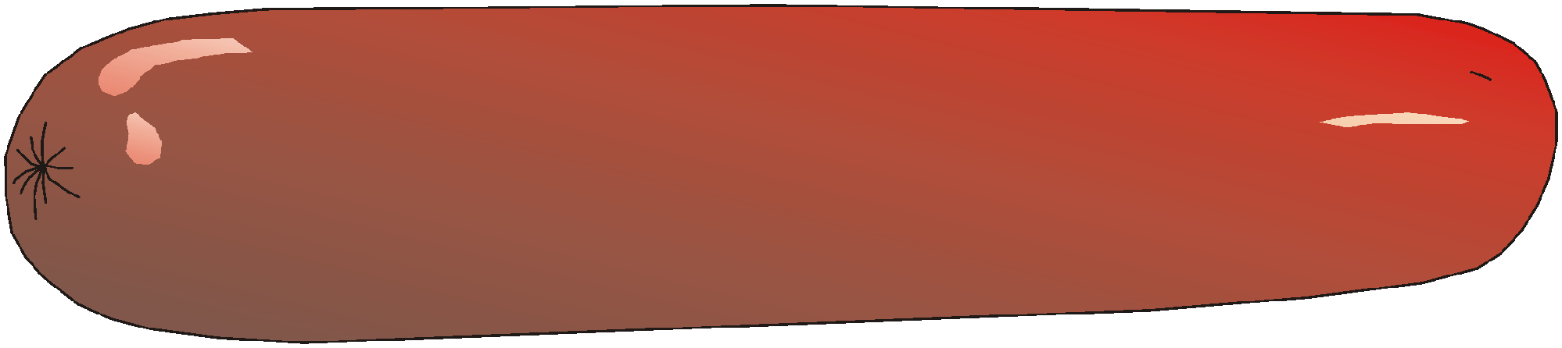
Line/Loop/Roll/Horizontal Circle COMBINATIONS
Radii are equal
1/2 roll before
completing1/2 loop…
…use 1 point/15 degree downgrade!
DOUBLE
IMMELMANN
(note shape…two loops are joining!
1/2 loop
1/2 loop
SINGLE
IMMELMANN
Line before 1/2 roll... minus 2 points!
1/2 roll directly after 1/2 loop
1/2 roll directly
after 1/2 loop
Line before 1/2 roll... minus 2 points!
DOUBLE IMMELMANN
IS NOT A SAUSAGE

Slide 60
Line/Loop/Roll/Horizontal Circle COMBINATIONS
3/4 loop
SQUARE LOOP
ON CORNER
¹/₄
loop
All lines 45⁰. All lines equal length
¹/₄
loop
Radii all equal
¹/₄
loop
1/2 roll
on middle
of line
Radii equal
Rolls in middle of lines
1/8 loop entry and exit
FIGURE 9
1/4 loop

Slide 61
Line/Loop/Roll/Horizontal Circle COMBINATIONS
Radii equal
1/8
loop
GOLF BALL
3/4
loop
Radii all equal
1/2 roll
on middle
of line
1/8
loop
45⁰ DOWN
1/8
loop
1/8
loop

Slide 62
Line/Loop/Roll/Horizontal Circle COMBINATIONS
VERTICAL 8
(Note shape: loops are barely touching)
HUMPTY BUMP
1/4
loop
1/4
loop
Radii not
equal!
Loop
not round
Straight
flight here…
downgraded!
Loop not round
1/2
loop

Slide 63
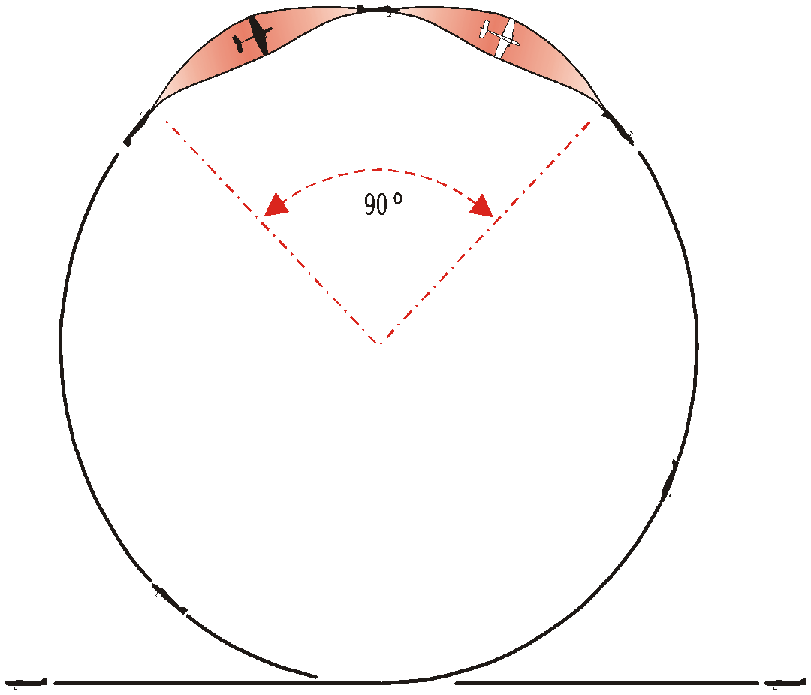
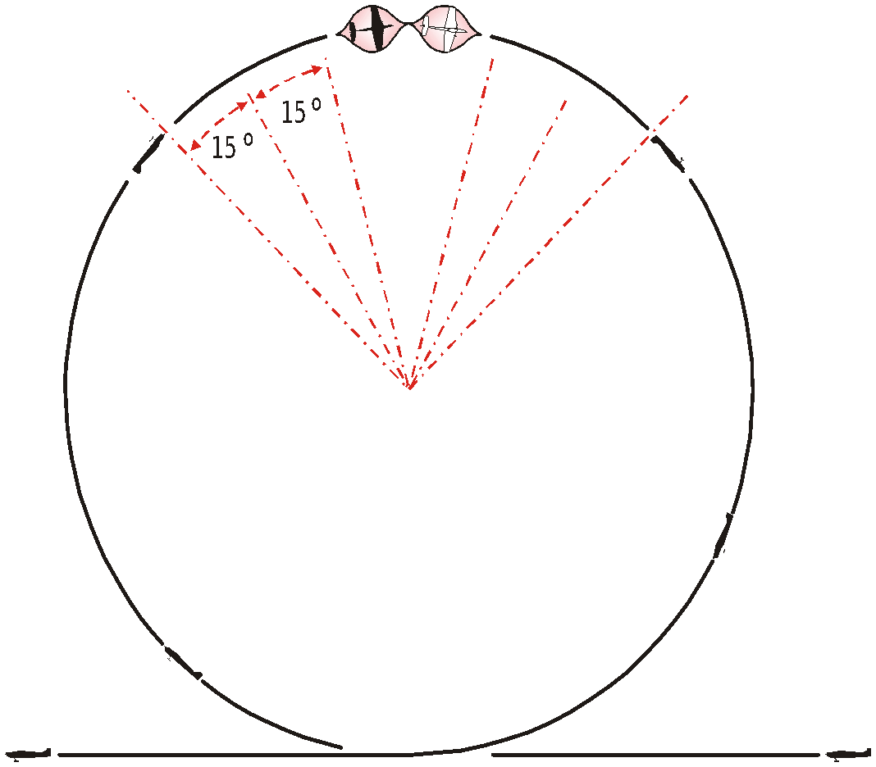
Line/Loop/Roll/Horizontal Circle COMBINATIONS
LOOPS WITH INTEGRATED ROLLS
Rapid rolls MUST score less. This example = minus 4 for non-integration of roll
Rolls or part rolls
integrated with loop
Loops must be ROUND!

Slide 64
STALL TURNS
Up to 1½ span radius
minus 4/5 points!
Up to ½ span radius of pivot…
minus 1 point!
Up to one wing span radius...
minus 2/3 points!
Pivot on CG…
no downgrade!
Over 15⁰
off vertical…
minus 2 points!
Pendulum
after
stall...
minus 1!
Roll not
on middle
of line...
minus 1 point!
Roll not on
middle...
minus 1 point!
Roll on middle of line... no downgrade!
No line before roll…
minus 3 points!
Notes:
About lines
Exactly vertical and horizontal FLIGHT PATHS
Torque-off: 1 point per 15 degree-rule

Slide 65
STALL
TURNS
“Skid” before reaching
Stall position…
Wing-over…
ZERO!
Torque-off…
1pt/15 degree
downgrade
Minus 1
point!
Wing-over =
2 wing spans
or more.
Flop forwards,
or backwards… ZERO!

Slide 66
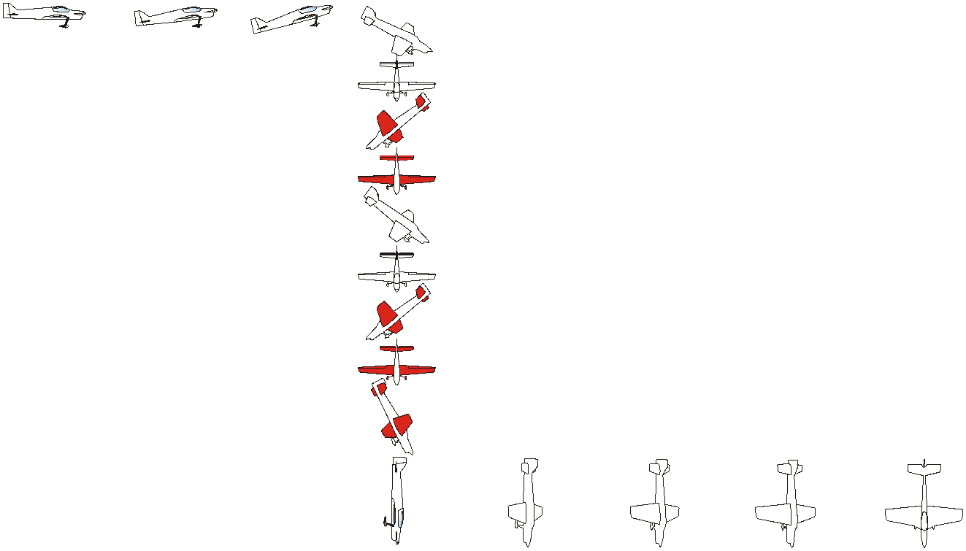
SPINS
Level
entry
Nose-up attitude
increases
Stall…
nose and wing drops…
rotation starts
Nose-up
attitude
30° to 45°
…minus 3!
Model aircraft
spins around CG
15° to 30°
…minus 2!
90° overspin
...minus 6!
Up to 15°
…minus 1!
STOP, with
no over- or
under-spin
Vertical downline
after spin

Slide 67
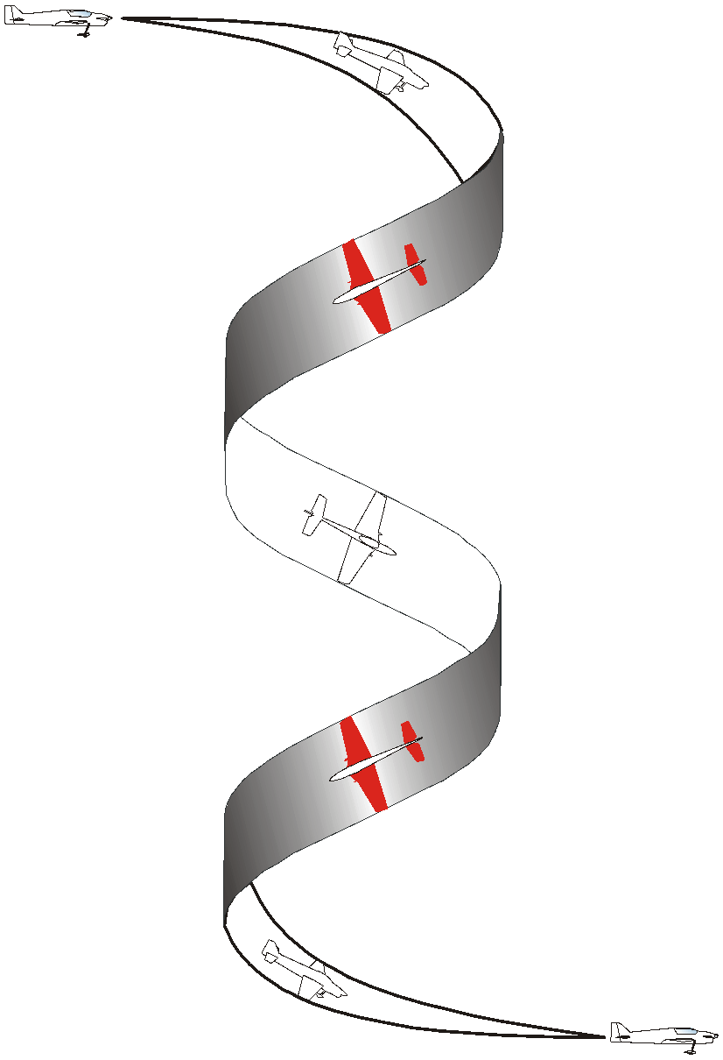
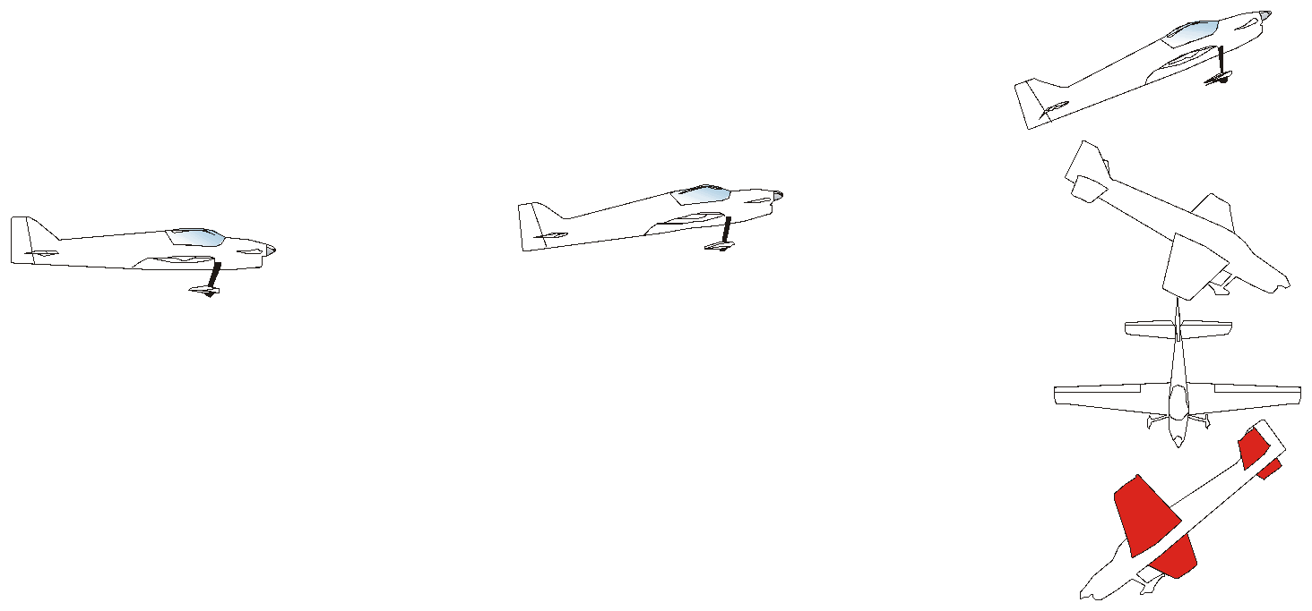
SPINS
Wing lift (snap entry)…ZERO!
Forced with
down-elevator…
minus 4 or 5!
Climbing…
downgrade, using 1pt. per 15 degrees!
Spiral dive…scores ZERO!

Slide 68
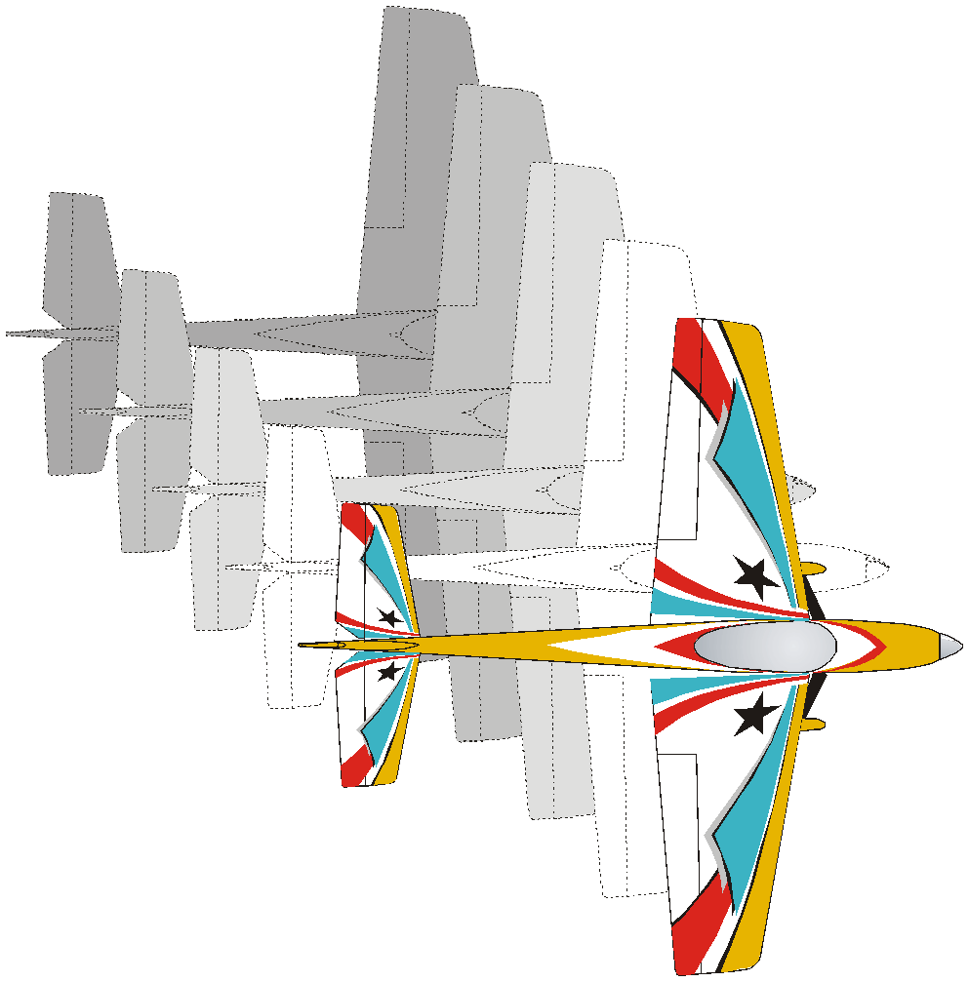
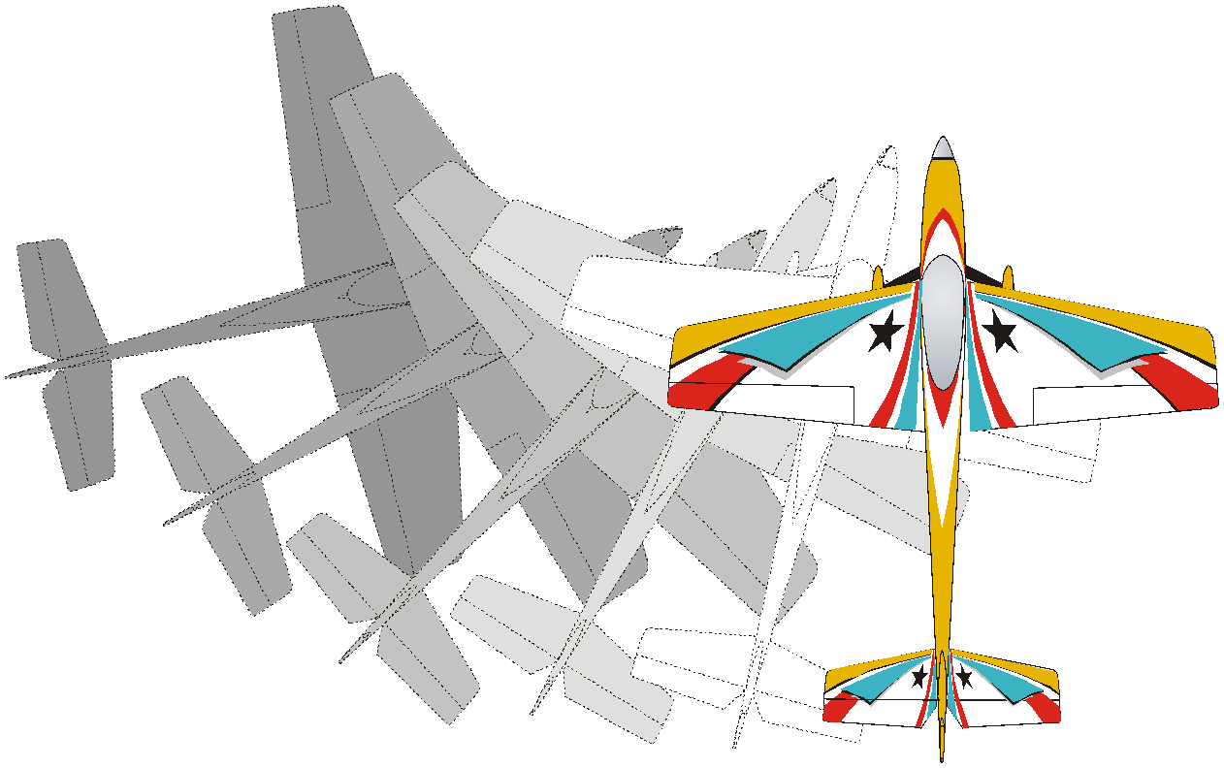
SPIN: DRIFT, OR WEATHERCOCK?
Up to 300 off…
minus 2 points!
No penalty
for drifting
with wind.
Up to 15° off…
minus 1 point!
minus 3 points!
- 4
- 5
- 6!
A weathercock is fixed to the earth, but free to swivel into the prevailing wind.
A model aircraft
is not fixed to anything!
Direction of flight

Slide 69
Smoothness and Gracefulness
of the Manoeuvre
Harmonic appearance of the entire manoeuvre
Constant flightspeed
Radii not too tight and not too loose
Rolling speed not to low or too high

Slide 70
LONGITUDINAL POSITIONING
Manoeuvres out of box here,
are penalised more...
…than manoeuvres
out of box here.
Manoeuvres positioned here
not penalised
520m
150m
300m
120⁰

Slide 71
LONGITUDINAL POSITIONING
5B4.5: “Manoeuvres on a line greater than ±175m MUST BE DOWNGRADED”
275m
– 5
– 4
– 3
– 2
– 1
250m
225m
200m
175m
150m = ideal
flight distance

Slide 72
LONGITUDINAL POSITIONING
225 m-250 m minus -3 points
200 m-225 m minus -2 points
175 m-200m minus 1 point
150 m-175 m OK
520m
150m
300m
120⁰
Notes:
VISIBILITY!
Middle manoeuvres centred on flag
Entire manoeuvre out = ZERO!
Parallax problem?

Slide 73
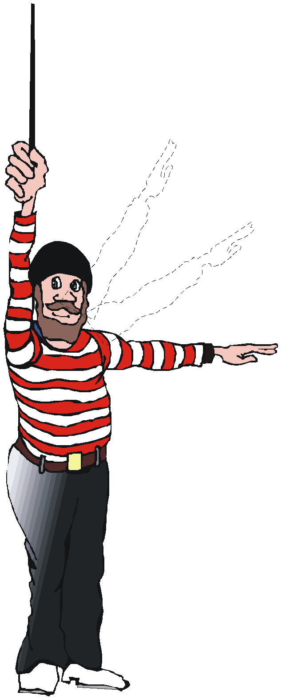
VERTICAL POSITIONING (Height)
90⁰
60°
30⁰
260m
0⁰
60⁰
150m to flag
Notes:
60 degrees = quite steep!

Slide 74

CENTRE POSITIONING
Off-centre positioning…
minus 3 or 4 points!
(for this example)
Notes:
Perfect in every respect:
Right distance
Correct angle
Same-sized part-loops
Roll in middle
Good level entry and exit

Slide 75

CENTRE POSITIONING
Off-centre positioning…
minus 2 or 3 points!
(for this example)

Slide 76
Size of the manoeuvres
The size of a manoeuvre is scored by it‘s matching size relative to the size of manoeuv-ring zone and relative size of the other manoeuvres performed throughout the schedule

Slide 77
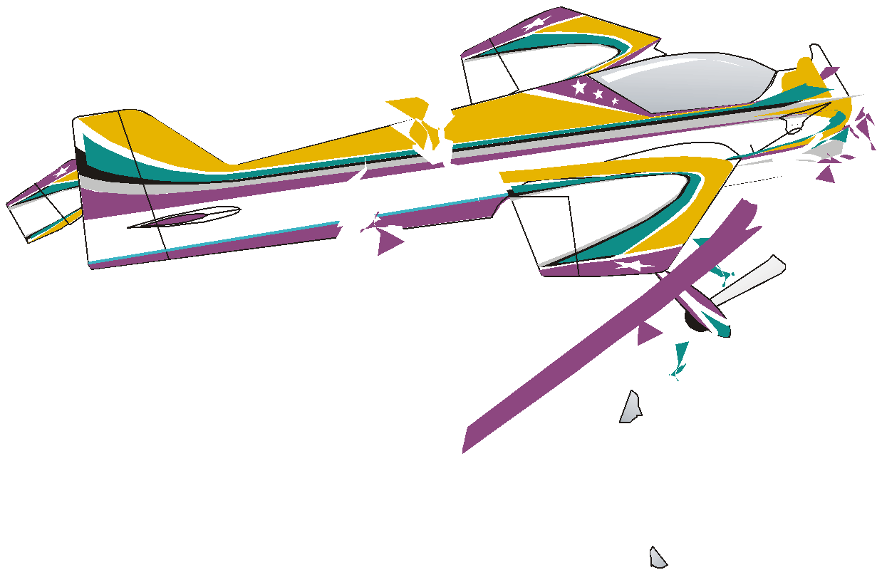
Proportion of the manoeuvre outside of the manoeuvring zone
Box markers are indicators only.
Do not downgrade unnecessarily!
Notes:
Box ends not brick walls!
T/A introduced to reduce flying area, and the reduce disturbance to environment
Also to make model aircraft come back!

Slide 78
Proportion of the manoeuvre outside of the manoeuvring zone
No downgrade
(positioning only)
(Entire manoeuvre
= inside box marker)

Slide 79
Proportion of the manoeuvre outside of the manoeuvring zone
2 points downgrade
(20% of manoeuvre = outside)

Slide 80
Proportion of the manoeuvre outside of the manoeuvring zone
5 points downgrade
(50% of manoeuvre = outside)

Slide 81
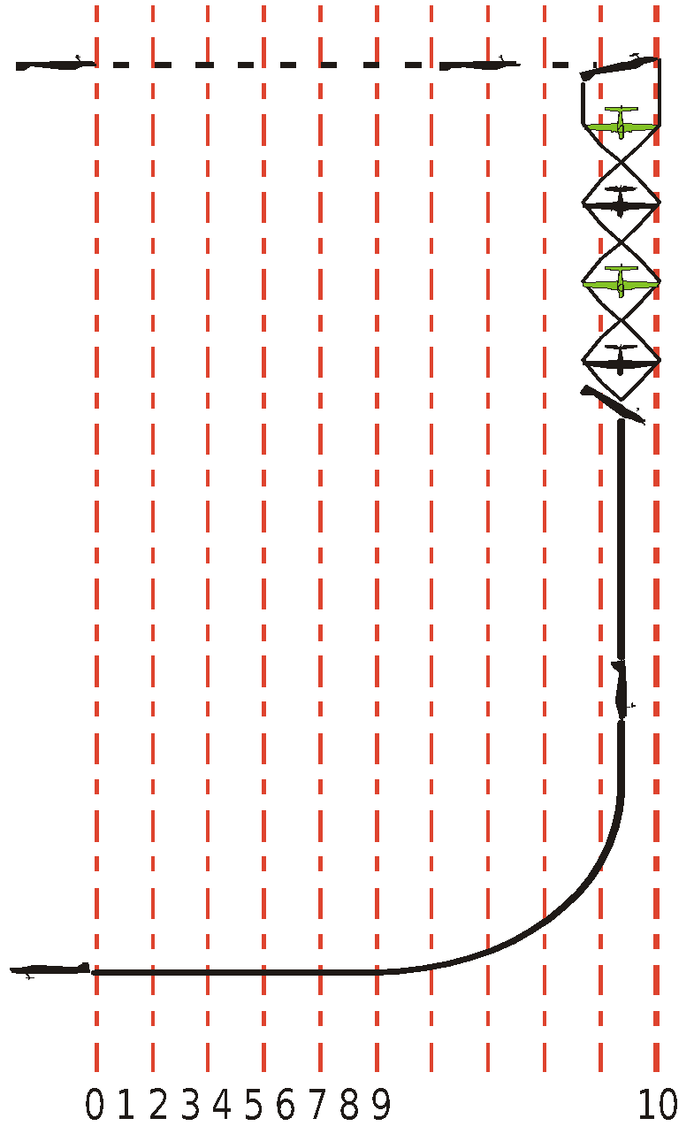
Proportion of the manoeuvre outside of the manoeuvring zone
No downgrade
(Entire manoeuvre = inside box marker)

Slide 82
Proportion of the manoeuvre outside of the manoeuvring zone
3 points downgrade for positioning.
(30% of manoeuvre = outside box marker)

Slide 83
Proportion of the manoeuvre outside of the manoeuvring zone
6 points downgrade for positioning.
(60% of manoeuvre is outside box marker.
60% is still inside!)

Slide 84
SCORE BETWEEN
10 and 0!
(NOT 8-7-6, or 7-6-5, or 6-5-4!)
Notes:
USE FULL RANGE!
Don’t be afraid of standing out!
Don’t wait for perfect manoeuvre!
If it were a good (or bad) manoeuvre, and if other judges were doing a good job, chances are that all will give similar scores
Guard against 5-6-7 scoring. Makes you a mediocre judge
Have good spread in scores to match spread in flying
See some good, some very good, many “average”, some poor, and some very poor flying (hopefully not!)

Slide 85
EVERY COMPETITOR…
STARTS EVERY FLIGHT…
WITH A
PERFECT SCORE!

Slide 86
BE CONSISTENT!
BE ACCURATE!
BE IMPARTIAL!
Notes:
FORGET WHO IS FLYING
LOOK AT MODEL AIRCRAFT AND ITS FLIGHT PATH
FORGET WHAT HE/SHE IS FLYING
HAVE RESPECT FOR COMPETITORS
HAVE RESPECT FOR YOURSELF!

Slide 87
DON’T DISCUSS FLIGHTS WITH FELLOW JUDGES
Notes:
May make other judges aware of something not previously noticed

Slide 88
USE N/O
(NOT OBSERVED)
Be FAIR to competitors,
and yourself!

Slide 89
Forget WHO is flying
(friend, rival, countryman, flier from other nation)
Forget WHAT is flying
(2-stroke, 4-stroke, electric, turbine, rubber-power)
LOOK ONLY AT LINES DESCRIBED IN THE SKY!
(and the precision, smoothness, positioning, and size)

Slide 90
Enjoy flying and judging!
Thanks to Michael for the new Manoeuvre Execution Guide
Thank you, Bob for most of the drawings!
Bob Skinner August 2008
Update Peter Uhlig, August 2011

